Slide 1
Object Oriented Design in practice
Instructor:

Slide 2
Agenda
After the course, student will:
Understand about software design principles from examples.
Understand and apply simple design pattern in the common situations.

Slide 3
How to avoid a bad design ?
3 important characteristics of a bad design:
Rigidity: It’s hard to change because every change affects too many other parts of the system.
Fragility: When you make a change, unexpected parts of the system break.
Immobility: It is hard to reuse in another application because it cannot be disentangled from the current application.
Notes:
Rigidity (nghiêm ngặt): It’s hard to change…
Fragility (dễ vỡ): When you make a change…
Immobility (không nhúc nhích): It’s hard to reuse…

Slide 4
Design Principles
Open Close Principle (OCP)
Dependency Inversion Principle (DIP)
Interface Segregation Principle (ISP)
Single Responsibility Principle (SRP)
Liskov's Substitution Principle (LSP)
Summary

Slide 5

Design Principles #1:Open Close Principle
Open for extension
But closed for modifications.

Slide 6
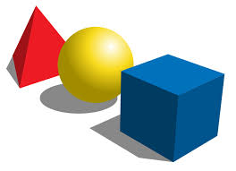
Design Principles #1: Graphic editor
Graphic editor is a program that has been developed to handle drawing other shapes (Circle, Rectangle, ...).
Notes:
Ví dụ này thực thi một graphic editor mà handle việc vẽ các hình khác nhau ( Rectangle, Circle).

Slide 7
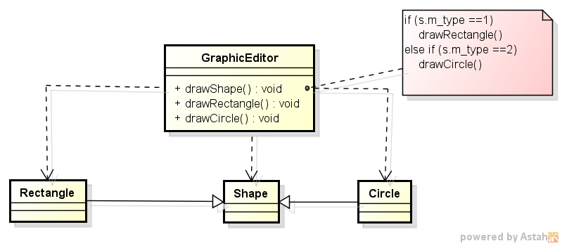
Design Principles #1: A temporal solution
Have GraphicEditor class to handle drawing
Have 2 classes representative to Rectangle and Circle objects.
Rectangle and Circle share so many properties, we create a new abstract base class (Shape).
Notes:
Thao tác vẽ hình nằm ở hàm drawShape() với tham số là kiểu Shape.
Nếu tham số này thuộc loại Rectangle thì sẽ gọi hàm drawRectangle() để vẽ hình Rectangle.
Và tương tự nếu tham số là thuộc về Circle thì xử lý sẽ gọi hàm drawCircle() để vẽ hình Circle.
Điều kiện để phán đoán tham số được xử lý bằng câu lệnh if trong hàm drawShape().

Slide 8
Design Principles #1: Violation points for extension
What are violation points for extension ?
When a new shape is added,
this should be changed
Notes:
- Lecture nên hỏi SV đâu là điểm vi phạm nguyên tắc Open Close trong ví dụ này:

Slide 9
Design Principles #1: Violation points for extension
Need re-create Unit Testing for GraphicEditor class, including drawShape() method.
Need deeply understand logic in “if” statement.
Affect the existing functionality.
Notes:
Trong trường hợp một hình mới () được add thêm thì cần phải modify lại xử lý trong câu lệnh if(trên hình vẽ) và khi đó:
1) Cần phải thực hiện lại unit testing cho class GraphicEditor, bao gồm hàm drawShape().
2) Developer cần phải hiểu rõ logic của xử lý trong câu lệnh if.
3) Có khả năng ảnh hưởng đến xử lý vẽ của hình Rectangle và Circle.
Do đó việc mở rộng của thiết kế này là khá khó khăn ( close for extension).

Slide 10
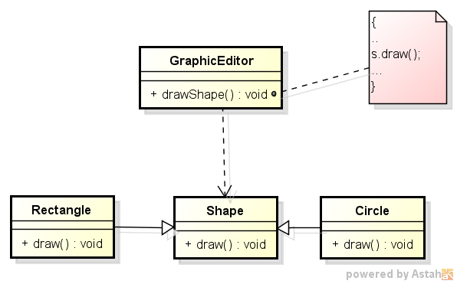
Design Principles #1: Improvement
no unit testing required.
no need to understand the sourcecode from GraphicEditor.
it's a reduced risk to affect old functionallity when new functionallity is added.
Polymorphism

Slide 11
Design Principles #1: Conclusion
OCP is only a principle.
Introduces new level of abstraction increasing the complexity of the code.
OCP should be applied in that area which are most likely to be changed.
Design patterns that help us to extend code without changing it such as : Decorator, Factory Method, Observer patterns, …

Slide 12
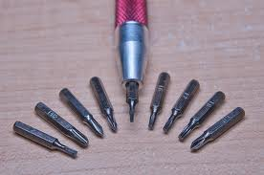
Design Principles #2: Dependency Inversion Principle
High-level modules should not depend on low-level modules. Both should depend on abstraction
Abstractions should not depend on details. Details should depend on abstractions.
Notes:
Low level classes the classes implement basic and primary operations(disk access, network protocols,...)
High level classes the classes encapsulate complex logic(business flows, ...).

Slide 13
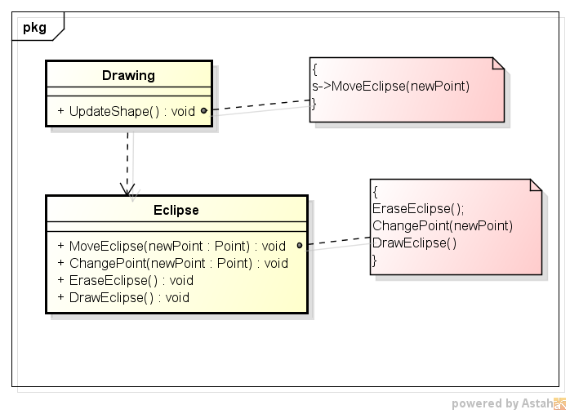
Design Principles #2: Problems
How to update a new Eclipse from old Eclipse when it moved to other position ?
Erase old Eclipse at the current point.
Change new point for Eclipse.
Draw new Eclipse at new point.
Dependency
Notes:
Ví dụ này mô tả việc cập nhật hình khi di chuyển một hình vẽ (Eclipse),
ta sẽ thực hiện các bước :
1) Xóa hình eclipse tại vị trí tọa độ hiện tại
2) Cập nhật tọa độ mới cho hình
3) Vẽ hình eclipse ở vị trí mới.
Drawing class đang thể hiện như vai trò của high level class
Trong khi Eclipse thể hiện vai trò low level class.
Bên cạnh đấy, trong bản thân class Eclipse: MoveEclipse() đóng vai trò high-level module, còn EraseEclipse(), DrawEclipse() và ChangePoint() đóng vai trò low level module.

Slide 14
Design Principles #2: Violation points of dependency
Drawing class depends on Eclipse class
MoveEclipse()
depends on
EraseEclipse()/ChangePoint()/DrawEclipse()
Notes:
Drawing class (high-level class) đang phụ thuộc vào Eclipse class (low-level class).
MoveEclipse() phụ thuộc trực tiếp vào 3 hàm EraseEclipse(), DrawEclipse() và ChangePoint().
Vì thế đã vi phạm vào nguyên tắc Dependency Inversion.
Yêu cầu sinh viên trả lời -> chuyện gì sẽ sảy ra khi ta cần thực hiện cập nhật hình khi di chuyển một hình … Circle ?

Slide 15
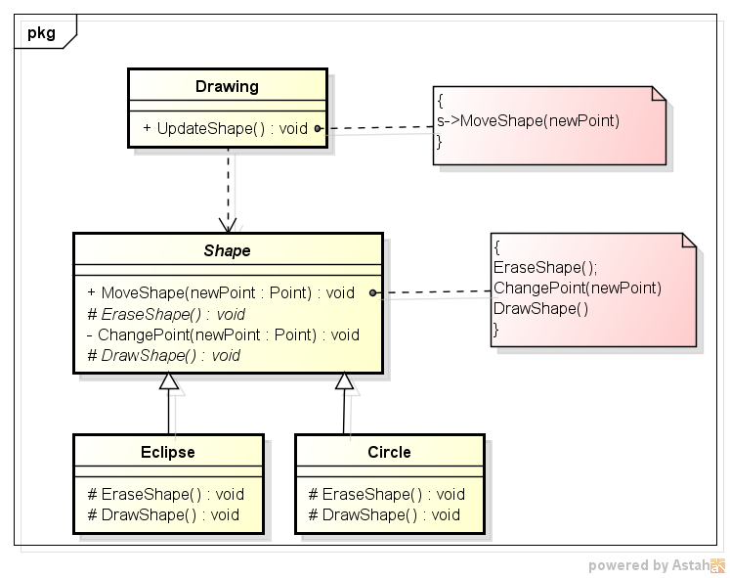
Design Principles #2: Improvement
Depends on abstract class.
Abstract methods are implemented by child classes.
Template Method design pattern
Notes:
Drawing class (high-level class) không phụ thuộc vào Eclipse class (low-level class) mà phụ thuộc vào abstract class ( Shape).
MoveShape() trong class Shape chỉ phụ thuộc trực tiếp vào hàm ChangePoint() (xử lý common cho các loại Eclipse, Circle). 2 hàm EraseEclipse(), DrawEclipse() là abstract method và được implement cụ thể trong Eclipse hay Circle class.

Slide 16
Design Principles #2: Conclusion
This principle means that the high level classes are not working directly with low level classes.
Should use some creational design patterns can be used, such as Factory Method, Abstract Factory, Prototype to instantiate new low level objects inside the high level classes.
The Template Design Pattern is an example where the DIP principle is applied.
If we have a class functionality that is more likely to remain unchanged in the future there is not need to apply this principle.
Notes:
In this case instantiation of new low level objects inside the high level classes(if necessary) can not be done using the operator new. Instead, some of the Creational design patterns can be used, such as Factory Method, Abstract Factory, Prototype.

Slide 17
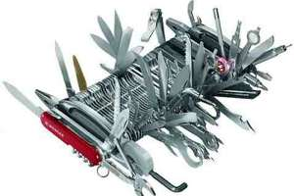
Design Principles #3:Interface Segregation Principle
Many client specific interfaces are better than one general purpose interface
Notes:
Nếu có một class đối tượng được sử dụng bới nhiều Client, thay vì dồn hết các chức năng vào trong class đối tượng đó thì chúng ta sẽ phân loại các chức năng ứng với nhu cầu của từng Client.

Slide 18
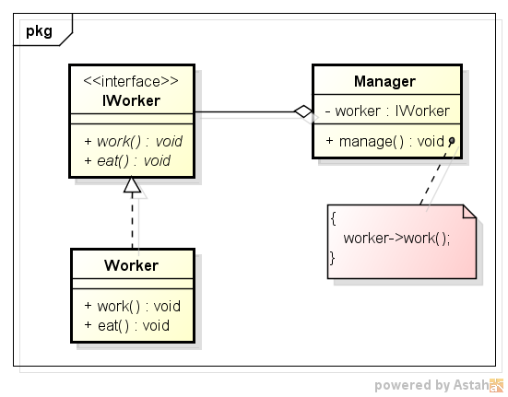
Design Principles #3: Example
Workers work and they need a daily launch break to eat.
Worker class implements IWorker interface with work() and eat() method.
Manager class which represent the person which manages the workers and only use work() method from IWorker interface.
Notes:
Với phương pháp “chia để trị” như hình bên phải , thiết kế đảm bảo rằng những thay đổi để đáp ứng nhu cầu của bất kỳ Client nào cũng không thể ảnh hưởng đến các Client còn lại.

Slide 19
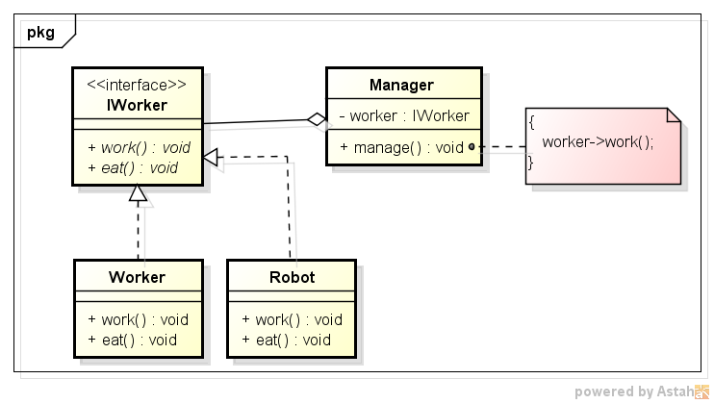
Design Principles #3: Detect problems
Add new Robot class and it need to implement the IWorker interface because robots works.
But the new Robot class don't have to implement eat() method because they don't eat.
If we keep the present design, the new Robot class is forced to implement the eat method.

Slide 20
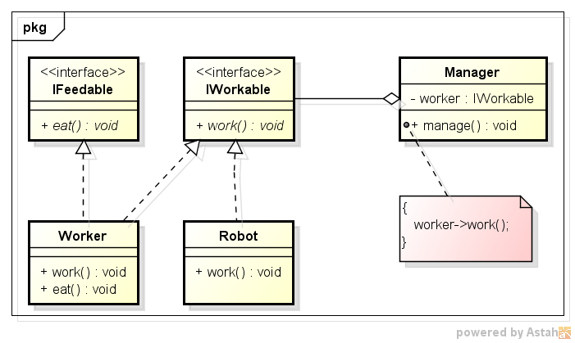
Design Principles #3: Improvement
Divide IWorker to IFeedable & IWorkable
Robot class no need implement eat() method.
Notes:
Với phương pháp “chia để trị” như hình, thiết kế đảm bảo rằng những thay đổi để đáp ứng nhu cầu của bất kỳ Client nào cũng không thể ảnh hưởng đến các Client còn lại.

Slide 21
Design Principles #3: Conclusion
If the design is already done fat interfaces can be segregated using the Adapter pattern.
If we are going to apply it more than is necessary it will result a code containing a lot of interfaces with single methods and increase the complexity of code.

Slide 22
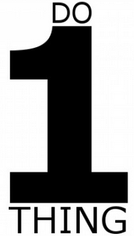
Design Principles #4: Single Responsibility Principle
A class should have only a single responsibility

Slide 23
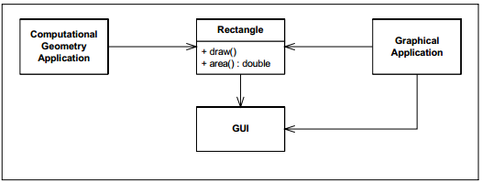
Design Principles #4: Still example
The Rectangle class has two responsibilities:
The first responsibility is to provide a mathematical model of the geometry of a rectangle.
The second responsibility is to render the rectangle on a graphical user interface
The Rectangle class has two methods shown.
It may also do some computational geometry, but it definitely draws the rectangle on the screen.
It uses Rectangle to help it with the mathematics of geometric shapes.
Two different applications use the Rectangle class
Notes:
Hình trên mô tả 1 ví dụ violate the SRP
The Rectangle class has two methods shown. One draws the rectangle on the screen, the other computes the area of the rectangle.
Two different applications use the Rectangle class:
One application does computational geometry. It uses Rectangle to help it with the mathematics of geometric shapes. It never draws the rectangle on the screen.
The other application is graphical in nature. It may also do some computational geometry, but it definitely draws the rectangle on the screen.
The Rectangle class has two responsibilities:
The first responsibility is to provide a mathematical model of the geometry of a rectangle.
The second responsibility is to render the rectangle on a graphical user interface.
The violation of SRP causes several nasty problems:
Firstly, we must include the GUI in the computational geometry application.
Secondly, if a change to the GraphicalApplication causes the Rectangle to change for some reason, that change may force us to rebuild, retest, and redeploy the ComputationalGeometryApplication.
A better design is to separate the two responsibilities into two completely different classes as shown [Hình bên dưới].
This design moves the computational portions of Rectangle into the GeometricRectangle class.
Now changes made to the way rectangles are rendered cannot affect the ComputationalGeometryApplication.

Slide 24
Design Principles #4: Detect problems
The violation of SRP causes several nasty problems:
Must include the GUI in the computational geometry application.
If a change to the GraphicalApplication causes the Rectangle to change for some reason, that change may force us to rebuild, retest, and redeploy the ComputationalGeometryApplication.

Slide 25
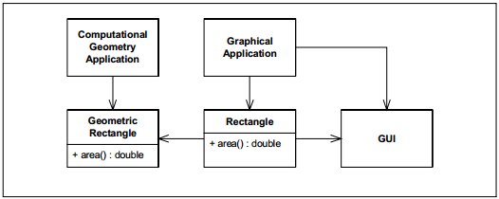
Design Principles #4: Improvement
Separate the two responsibilities into two completely different classes
Changes made to the way rectangles are rendered cannot affect the ComputationalGeometryApplication
Moves the computational portions of Rectangle into the GeometricRectangle class.
Notes:
A better design is to separate the two responsibilities into two completely different classes as shown [Hình bên tren].

Slide 26
Design Principles #4: Conclusion
Represent a good way of identifying classes during the design phase of an application
Remind to think of all the ways a class can evolve.
A good separation of responsibilities is done only when the full picture of how the application should work is well understood.

Slide 27
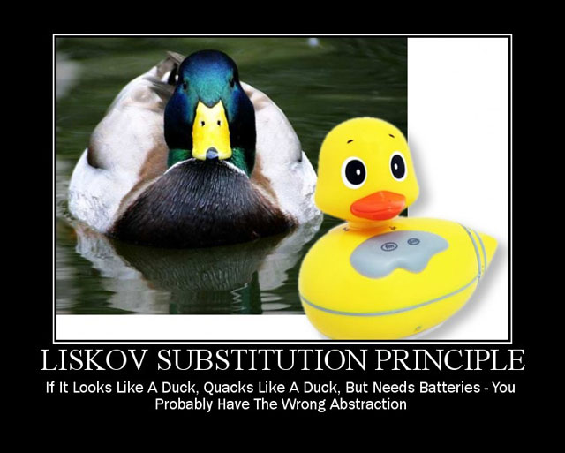
Design Principles #5: Liskov's Substitution Principle
Just an extension of the Open Close Principle.
Derived types must be completely substitutable for their base types.
Notes:
This principle is just an extension of the Open Close Principle and it means that we must make sure that new derived classes are extending the base classes without changing their behavior.

Slide 28
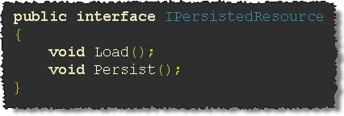
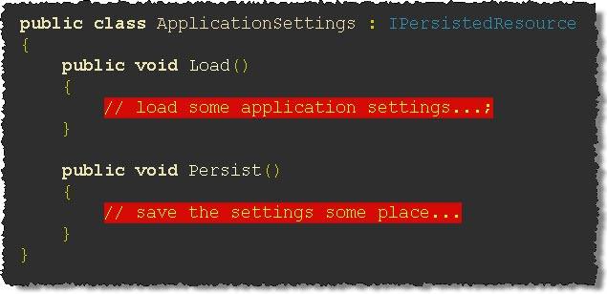
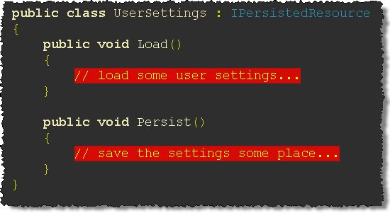
Design Principles #5: A bad example
Notes:
Chúng ta define 1 interface và 2 classes như trên hình vẽ.

Slide 29
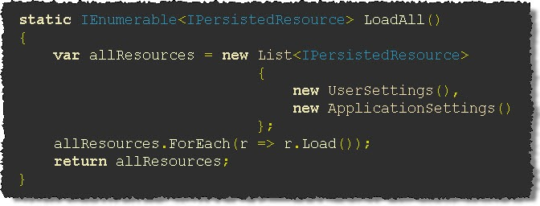
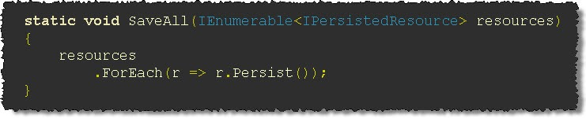
Design Principles #5: A bad example (cont.)
Notes:
Implement 2 hàm để load và save data.

Slide 30
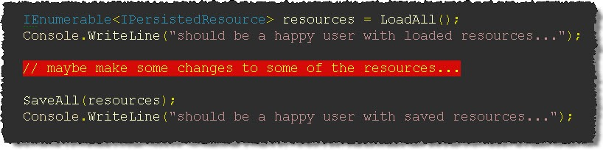
Design Principles #5: A bad example (cont.)
OK
Notes:
Lúc này khi chạy chương trình không có vấn đề gì.

Slide 31
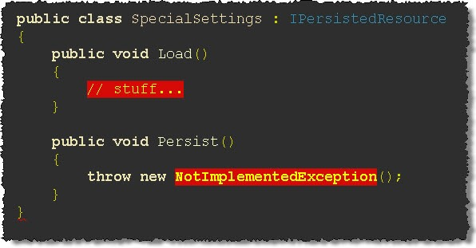
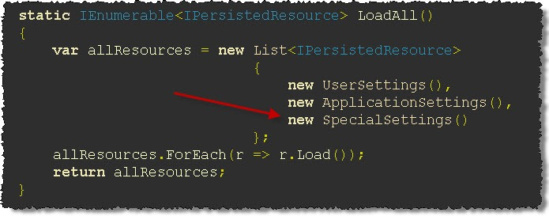
Design Principles #5: A bad example (cont.)
New class
Notes:
A new class is added to the system in order to handle, let’s say, some “special settings”:

Slide 32
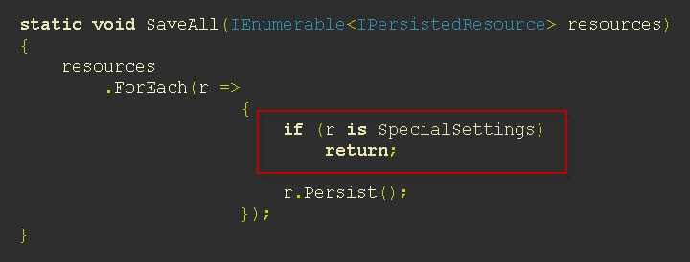
Design Principles #5: A bad example (cont.)
NG
Notes:
This principle is just an extension of the Open Close Principle and it means that we must make sure that new derived classes are extending the base classes without changing their behavior.

Slide 33
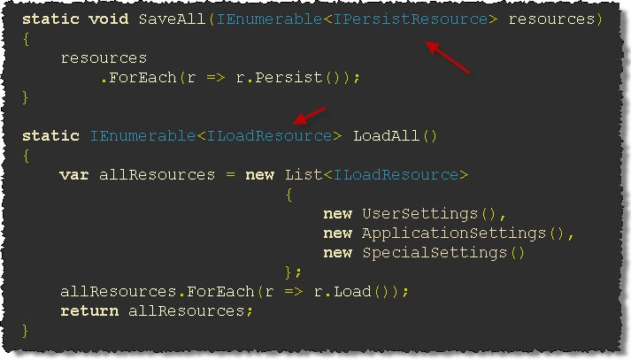
Design Principles #5: Improvement

Slide 34
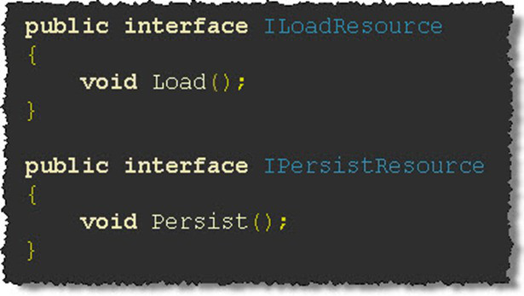
Design Principles #5: Improvement (cont.)
OK

Slide 35
Design Principles #5: Conclusion
LSP is about letting the user handle different objects that implement a super type without checking what the actual type they are.
This principle provides an alternative to do type-checking and type-conversion.
This principle is achieved through pull-up refactoring or applying patterns such as Visitor.

Slide 36
Summary
SRP - A class should have only one reason to change.
OCP - Open for extension but closed for modifications.
LSP - Derived types must be completely substitutable for their base types.
ISP - Many client specific interfaces are better than one general purpose interface.
DIP - High-level modules should not depend on low-level modules. Both should depend on abstraction.
Notes:
SOLID Principles

Slide 37
Summary (cont.)
Making a flexible design involves additional time and effort spent for it.
More complex code, but more flexible.
Applying should be done based on experience and common sense in identifying the areas where extension of code are more likely to happens in the future.

Slide 38
Reference
http://www.oodesign.com/design-principles.html
O'Reilly HeadFirst - Object Oriented Analysis and Design
O'Reilly HeadFirst - Design Patterns
Addison-Wesley Professional - Refactoring: Improving the Design of Existing Code

Slide 39


